Slide 1


CAPSTONE PROJECT
Under the Guidance:- Chirag Sir
Completed by:- Vrushal Mehta, Divyam Jain,
Harsh Vekariya, Prit Patel
Course:- Data Management & Visual Insight (SEM-2)

Slide 2
Introductions
Company Profile
Project Profile
Key Features of the Website
Course CatLog and Description
Login
Dashboard
Colour Pallet and fonts
Database Connection
Form Validation
Showing name of user after login
Fetching Data from Database
Add to cart system
HTML, CSS, JS, PHP, FIGMA
Table of Contents

Slide 3


Introduction to the Course Selling Website
Welcome to our comprehensive course selling platform, designed to provide a seamless and engaging experience for both learners and instructors. Explore a wide range of high-quality courses, secure your spot, and embark on a transformative educational journey.

Slide 4
Key Features of the Website
1
Intuitive Navigation
2
Course Previews
Our user-friendly interface makes it easy to browse, search, and discover the courses that align with your interests and goals.
Get a glimpse of the course content and format, allowing you to make informed decisions about your learning experience.
3
Database
4
Seamless Enrollment
Our intelligent algorithms suggest courses tailored to your preferences, ensuring you find the perfect fit for your needs.
Secure your spot in your desired courses with our streamlined registration and payment process.

Slide 5
Course Catalog and Descriptions
Professional Development
Creative Arts
Technology and Innovation
Unleash your artistic potential through our classes in photography, graphic design, and creative writing.
Enhance your career with our specialized courses in management, marketing, and entrepreneurship.
Stay ahead of the curve with our cutting-edge courses in data science, coding, and emerging technologies.

Slide 6



User Registration and Login
Create an Account
Secure Login
Personalized Dashboard
Sign up with your email and create a secure password to access our platform.
Use your registered credentials to log in and manage your courses and learning progress.
Enjoy a personalized dashboard to track your enrolled courses, progress

Slide 7
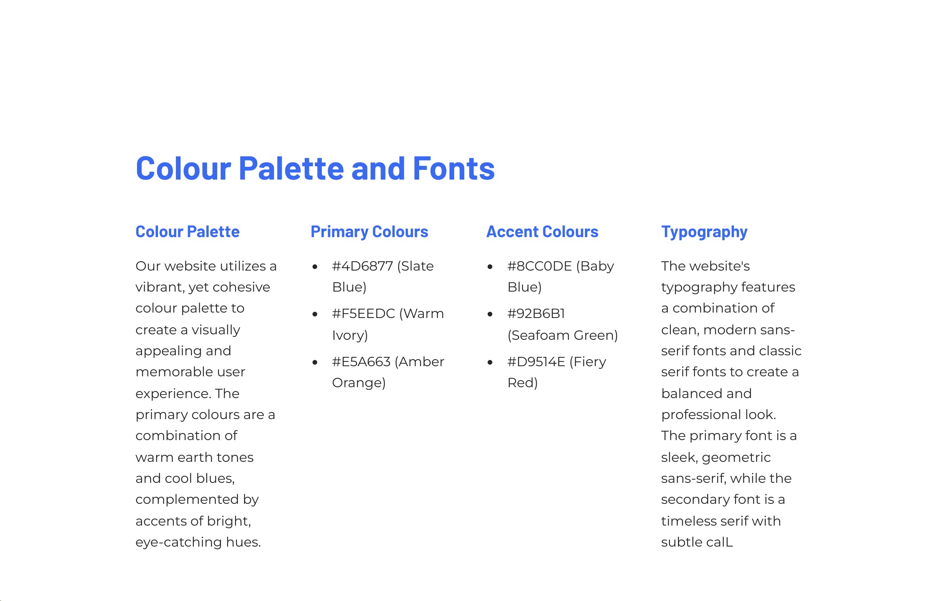

Slide 8
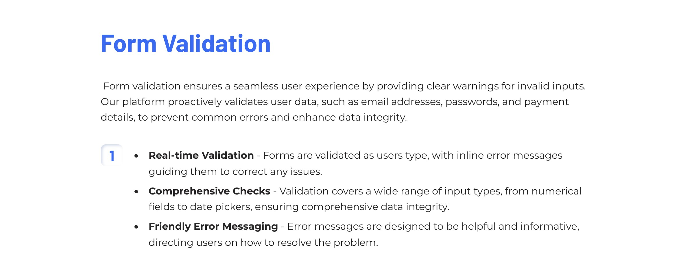

Slide 9
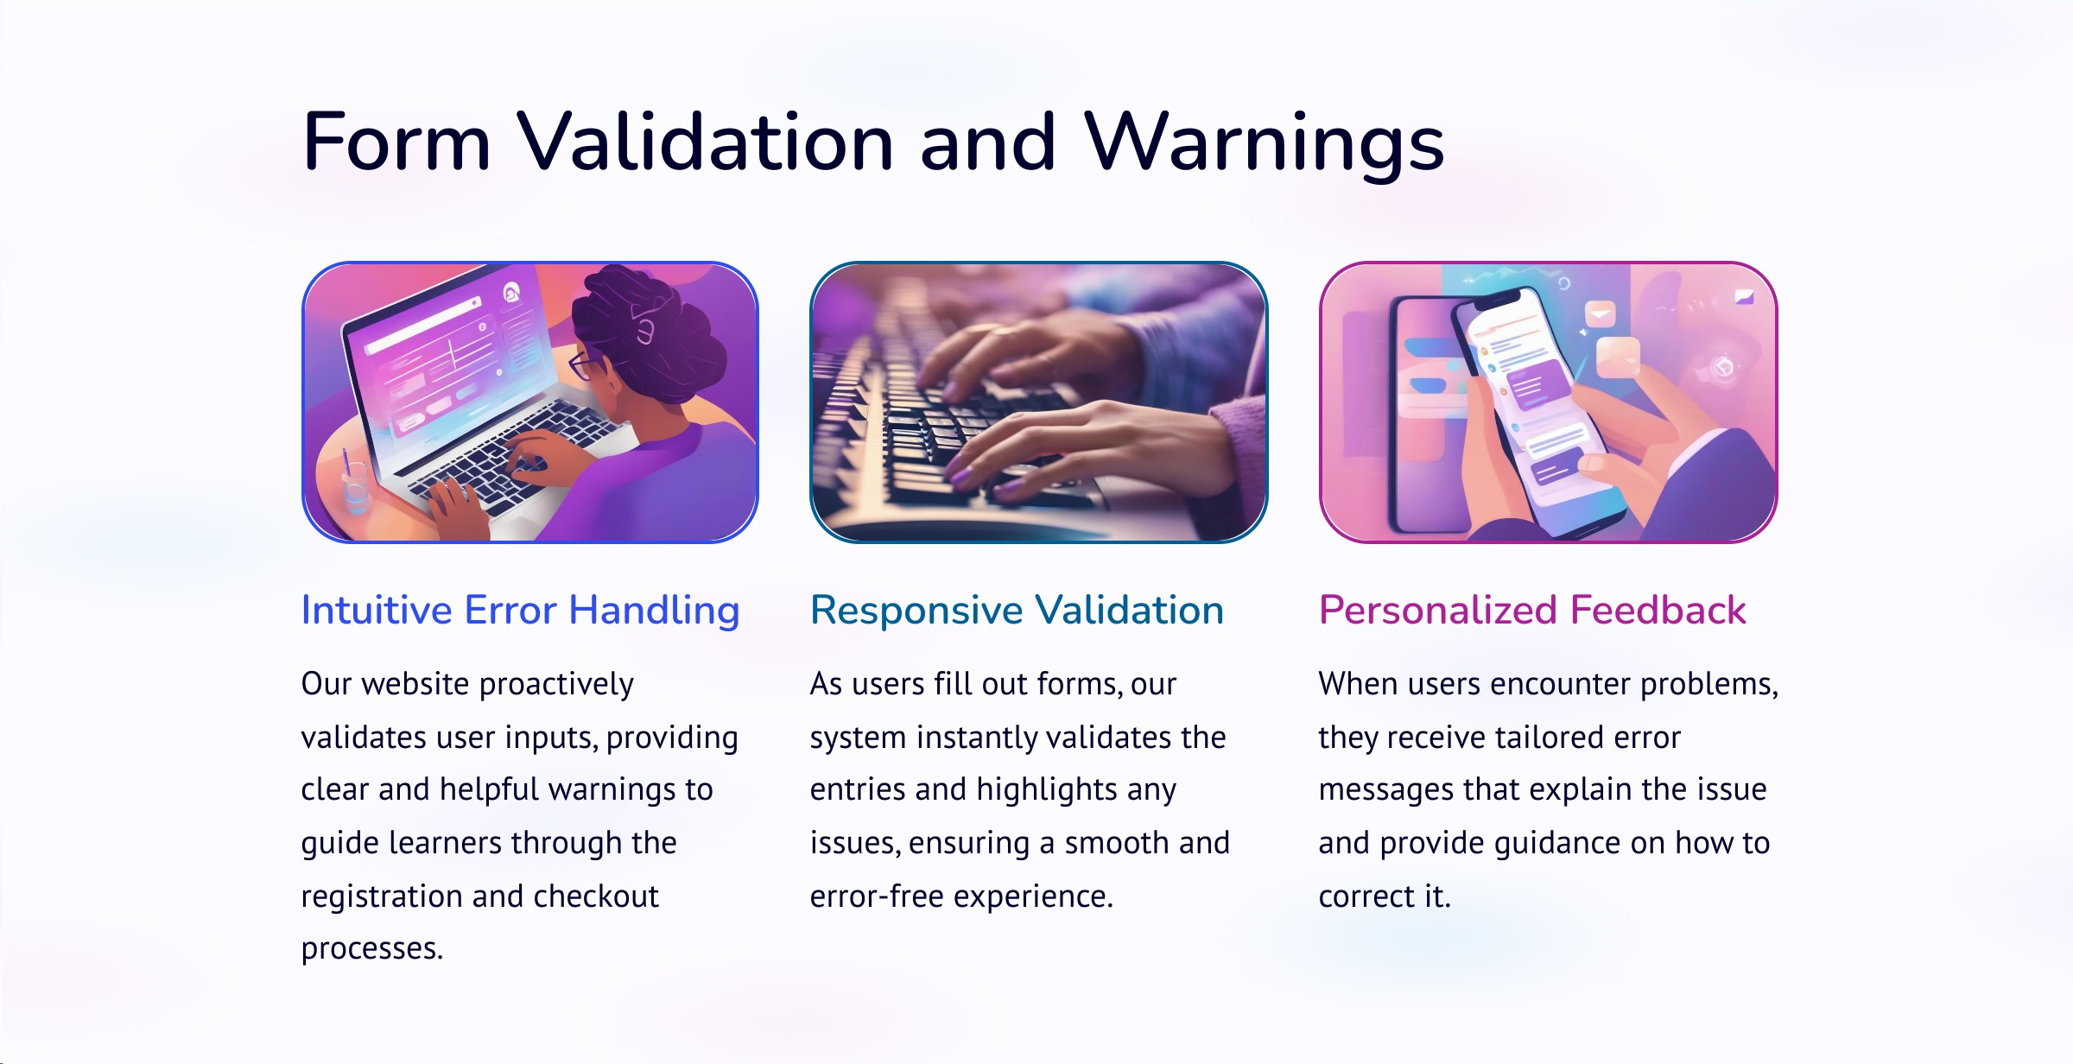

Slide 10
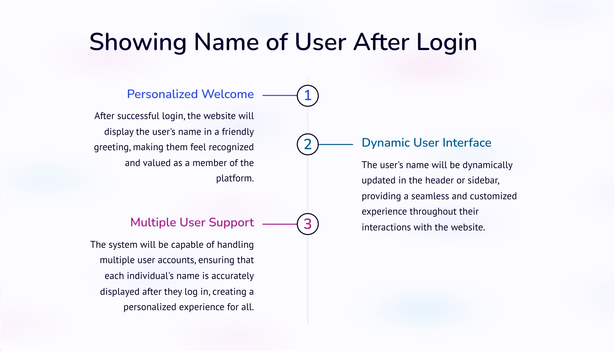

Slide 11
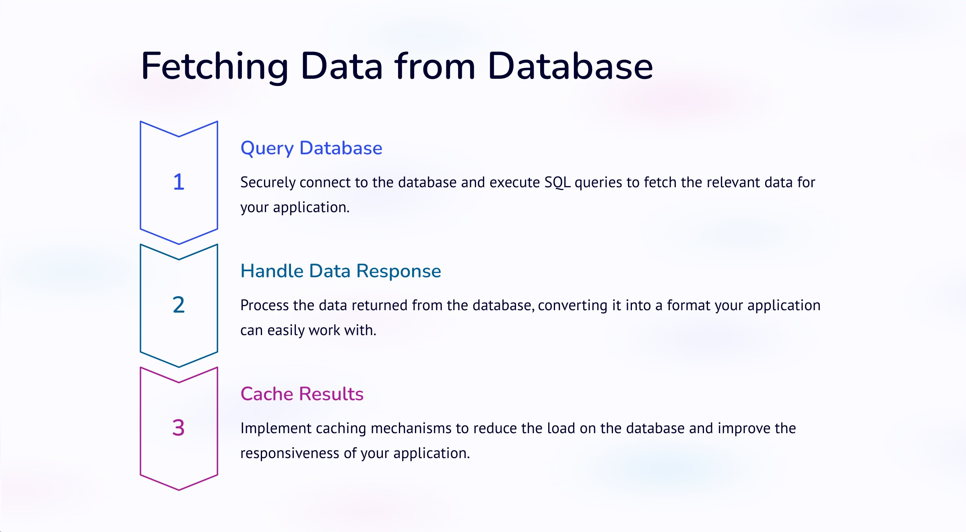

Slide 12
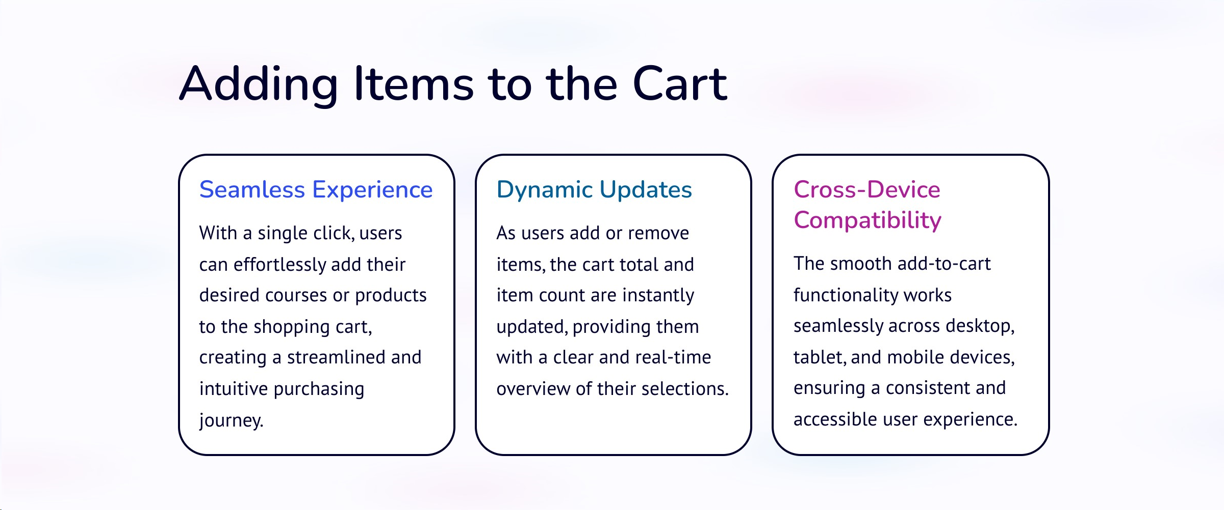

Slide 13
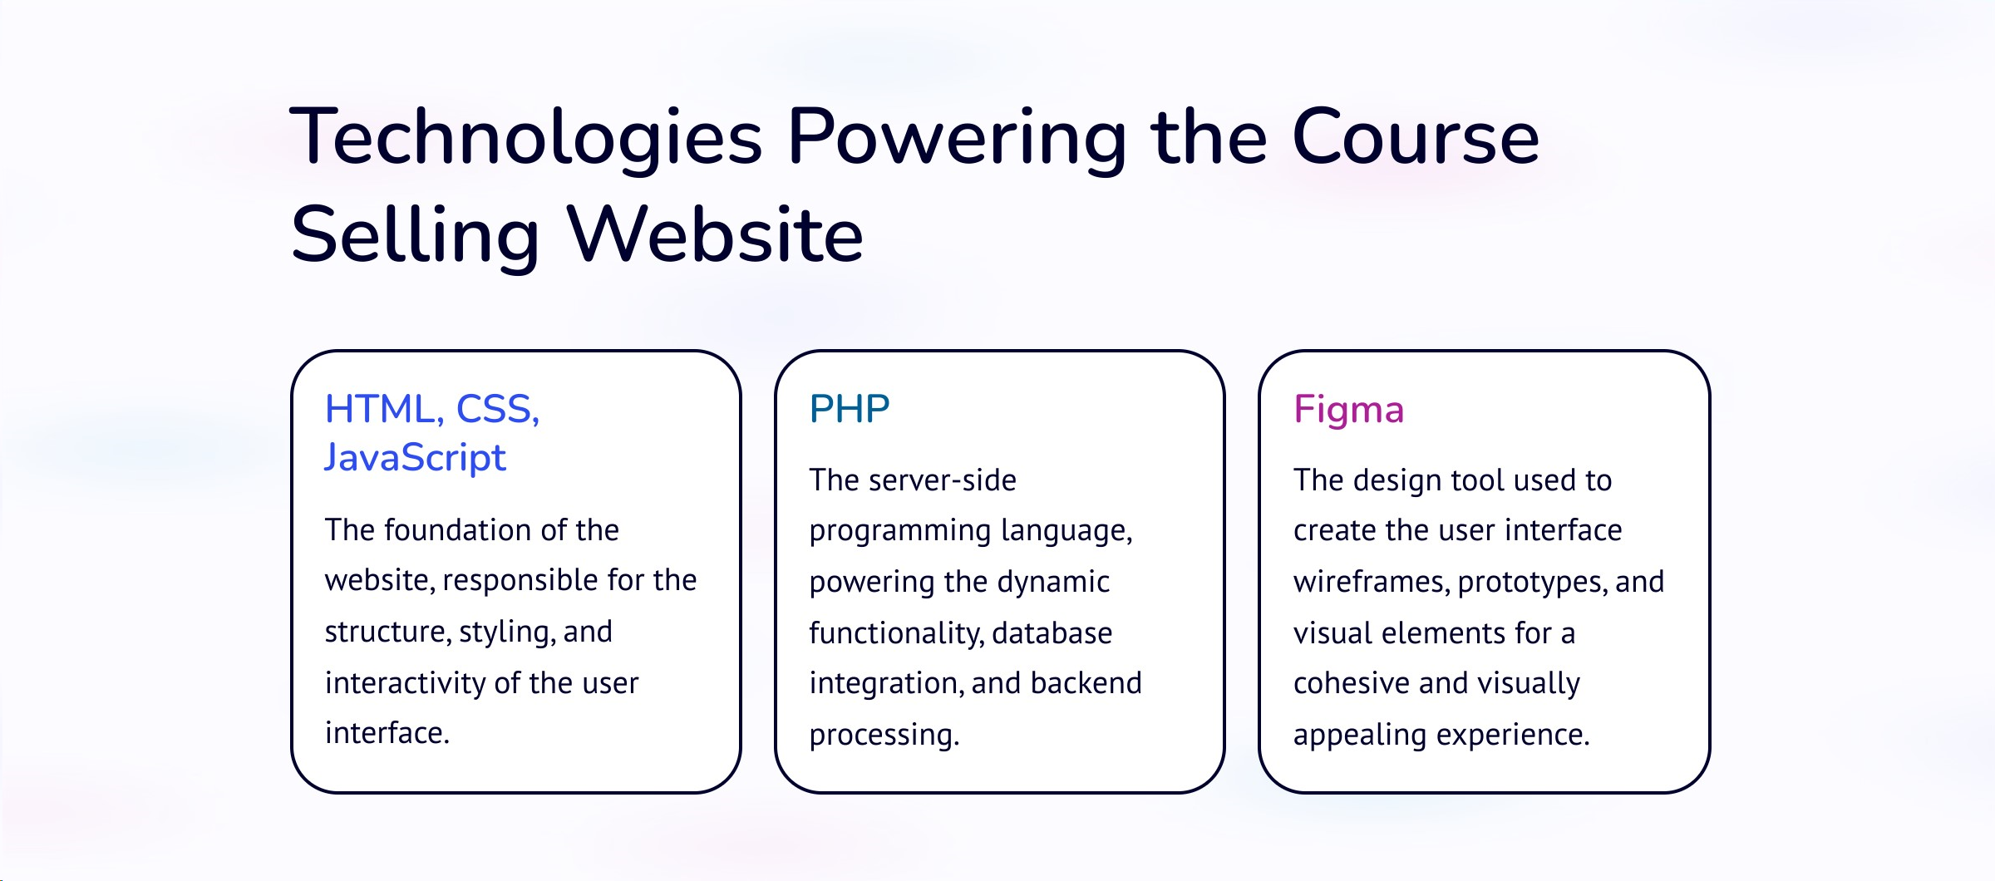

Slide 14


